Slide 1


VIRTUAL INTELLIGENCE SERVICE
VICTORIA PER INTELLECTUM
VIS STAFF INSTRUCTIONS
WIP
DISCLAIMER:
This is for multiplayer online gaming using the Digital Combat Systems simulation software published by Eagle Dynamics. The information is not in any way suitable for real world use or operations.
Version: 0.4 DRAFT
Published: 2020-10-15

Slide 2
Introduction
This document intends to support volunteers that take part in the VIS staff to create intelligence products for 132nd hosted events.
The document contain important information regarding how the VIS staff is working.
The document also contains links to relevant resource documents and
The aim of this report is to help pilots understand organization and structure of enemy air forces.
The structure in this document is generic and the actual structure in a operation is given as intelligence for that operation.

Slide 3
Version control
Version number | Date | Information changed
0.1 (DRAFT) | 2020-04-27 | Initial version Tips
0.3 (DRAFT) | 2020-08-04 | - Removed indicators(will be operation specific) - Added references

Slide 4
Content
Indicators
Input to VIS
Output from VIS
CombatFlite

Slide 5
VIS Purpose
VIS serves two purposes:
Intelligence to pilots:
The purpose of VIS is to provide intelligence to pilots in support of planning their flights.
Intelligence to JFACC
Intelligence fromVIS will be the background of taskings created by the JFACC/AOC for 132nd combat operations.
NOTE: JFACC/AOC can either be the mission host, or a designated indiviual without access to the mission file, and who will rely only on VIS intelligence for setting priorities and creating taskings

Slide 6
Tips
A intelligence report or intelligence summary normally contains 2 parts:
Information: This is reported information, or facts
Analysis: This is where the VIS staff look into the information available, other intelligence reports, and conducts its best assessment of the situation to give a understanding on what is happening.
The analysis is also supported by the indicators provided by the event host, that can aid in the understanding of a specific action or situation
As intelligence is not about knowing everything, there is a element of uncertainty. The confidence of the assessment can be expressed as high, moderate or low (See next slide)

Slide 7
Output: Products
Virtual Intelligence Service (VIS) can produce three different of reports.
Intelligence Reports (INTREP):
A intelligence report contains specific information about a topic, incidenc, unit
Intelligence Summaries (INTSUM):
A intelligence summary contains a summary of reported intelligence, BDA and assessment from VIS from one mission to the next
Target Folder (TF):
A target folder contains information about a specific target, and contains information that will be used by flights to plan their attack on the target.
In addition to these reports, VIS can also produce combatflite files with layers that can be used for planning. The combatflite files will have necessary information plotted into it.

Slide 8
Input
Virtual Intelligence Service (VIS) can receive input from several sources:
Pilots:
BDA reports from a mission
AAR/Inflight report from a mission
Intelligence report from a mission
External sources (event host):
Intelligence reports from higher
Various intelligence reports from other sources

Slide 9
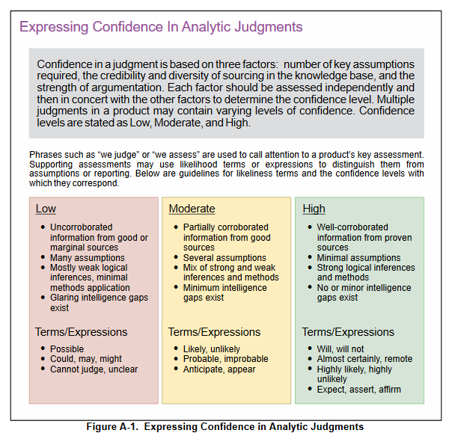
Expressing uncertainty
Source: Joint Publication 2.0: Joint Intelligence

Slide 10
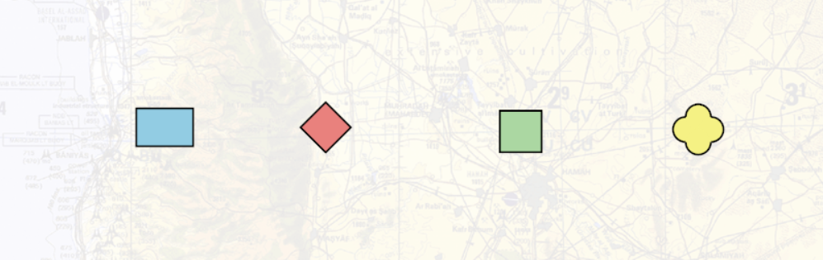
LEGEND
COMBATFLITE SYMBOLS
HOSTILE
UNKNOWN
FRIENDLY
NEUTRAL

Slide 11
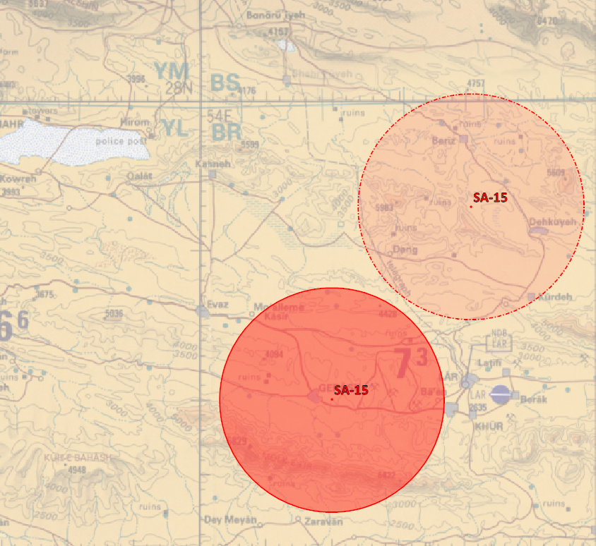
Combatflite
Uncertain intelligence
Confirmed intelligence

Slide 12
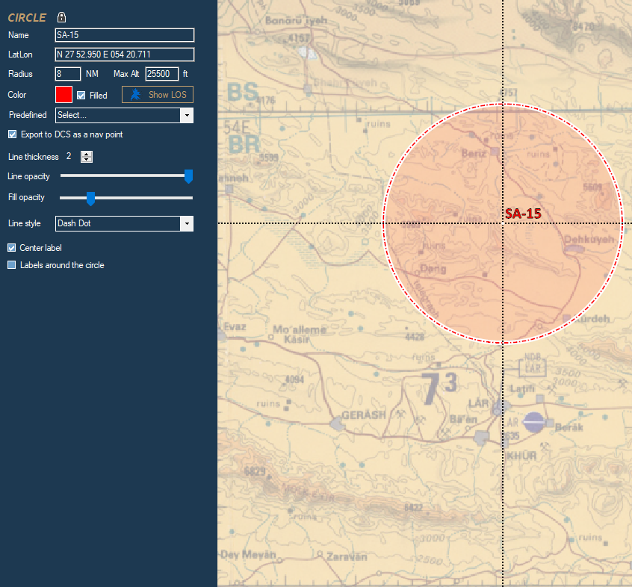
Combatflite symbols
Uncertain intelligence
For information that is uncertain, the circle will be drawn with fill opacity as shown below, and line style set as dash dot.

Slide 13
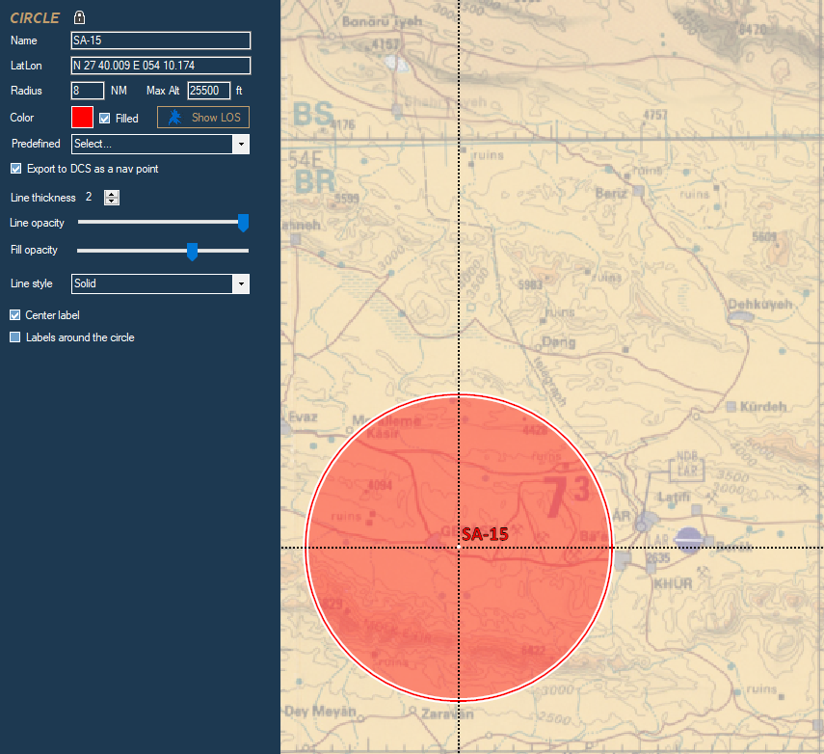
Combatflite symbols
Confirmed intelligence
For information that is confirmed, the circle will be drawn with fill opacity as shown below, and line style set as solid.

Slide 14
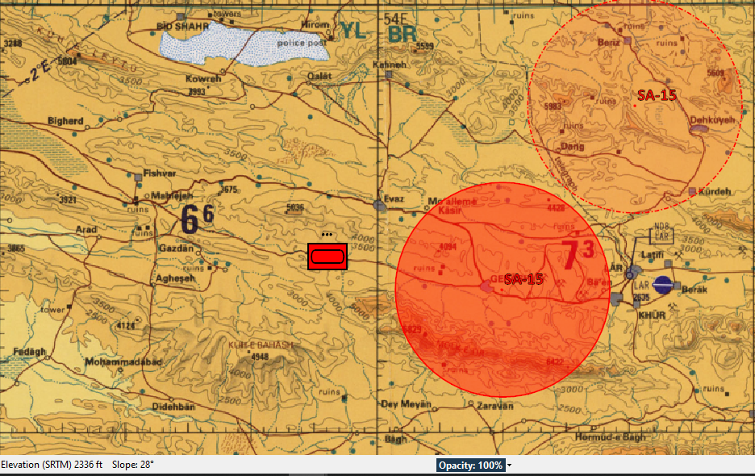
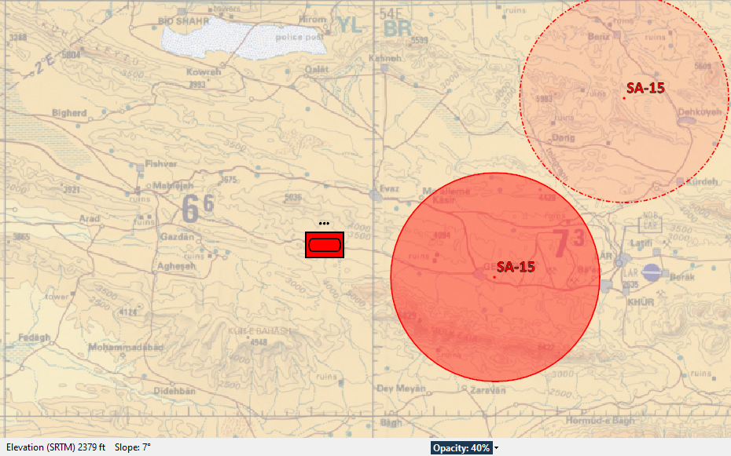
Combatflite opacity
In order for information on the map to stand out better, the opacity on the background map should be set to 40% on all pictures made for briefing/reports
Opacity selection

Slide 15
References
The following links can be used to gain a deeper understanding of the military intelligence function
http://pdf.textfiles.com/manuals/MILITARY/united_states_army_fm_34-8x2%20-%201_may_1998%20-%20part03.pdf
https://www.globalsecurity.org/military/library/policy/army/accp/is3001/lesson-5.htm
https://fas.org/irp/doddir/army/fm34-35/Appc.htm
https://www.trngcmd.marines.mil/Portals/207/Docs/MCIS/ITEP/MCWP_2-3_MAGTF_Intelligence_Production_and_Analysis_5.pdf

